Slide 1
Conditional Generation by GAN
（CGAN）
https://github.com/wilwiz/cgan
王海峰
2019/09/30

Slide 2


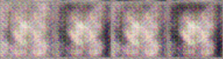
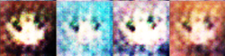
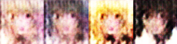




Basic idea of GAN
[Ref: http://speech.ee.ntu.edu.tw/~tlkagk/courses_MLDS17.html]
NN
Generator
v1
NN
Generator
v2
NN
Generator
v3
Discri-minator
v1
Discri-minator
v2
Discri-minator
v3
Real images:
Notes:
Binary
Classifier

Slide 3







Algorithm of GAN
[Ref: http://speech.ee.ntu.edu.tw/~tlkagk/courses_MLDS17.html]
G
D
Initialize generator and discriminator
In each training iteration:
Step 1: Fix generator G, and update discriminator D
sample
Update
1
1
1
1
D
generated objects
Database
0
0
0
0
randomly sampled
G
vector
Fix
vector
vector
vector
Discriminator learns to assign high scores to real objects and low scores to generated objects.

Slide 4
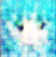
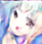
Algorithm of GAN
[Ref: http://speech.ee.ntu.edu.tw/~tlkagk/courses_MLDS17.html]
G
D
Initialize generator and discriminator
In each training iteration:
Step 2: Fix discriminator D, and update generator G
Generator learns to “fool” the discriminator
hidden layer
NN
Generator
Discri-minator
0.13
vector
update
fix
Gradient Ascent

Slide 5


Text-to-Image
text : $\hat{t} t$
NN
Generator
Image
x = G(t,z)
Normal distribution : z
text : $\hat{t} t$
NN
Discriminator
x is realistic or not
t and x are matched or not
scalar
x = G(t,z)

Slide 6
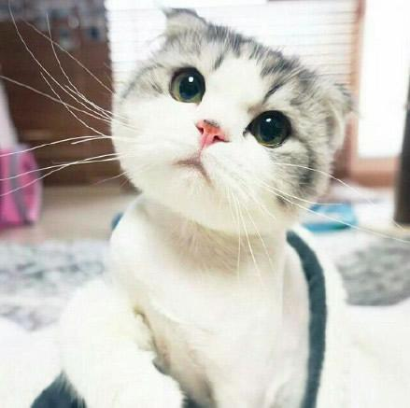
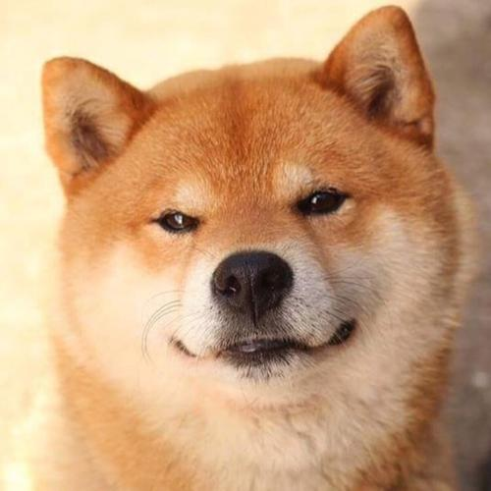

Text-to-Image
Problem 1:
GAN ignores the input conditions
Example:
True text-image pairs: (cat, )
Wrong pairs:
1
real text, fake image
(cat, )
0
real text, wrong image
(cat, )
0
wrong text, real image
(dog, )
0

Slide 7
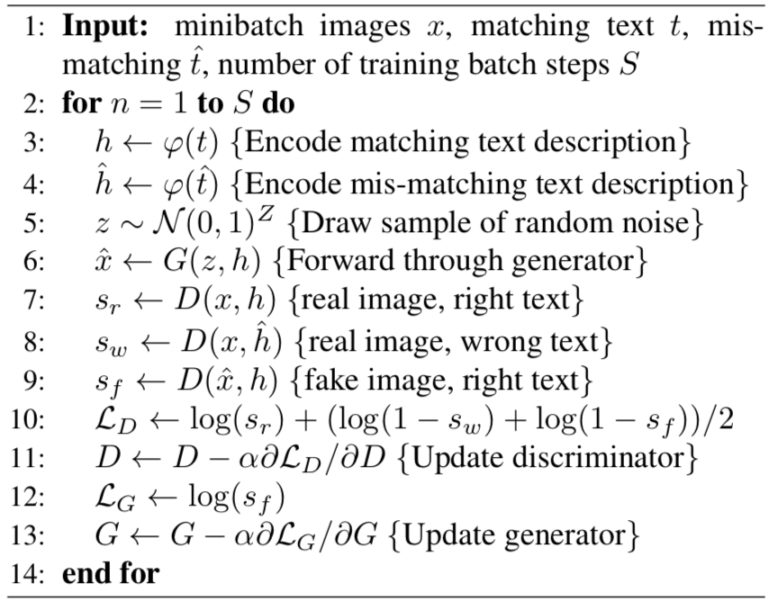
Matching-aware discriminator (GAN-CLS)
[S. Reed, et al., ICML, 2016.]
GAN-CLS

Slide 8
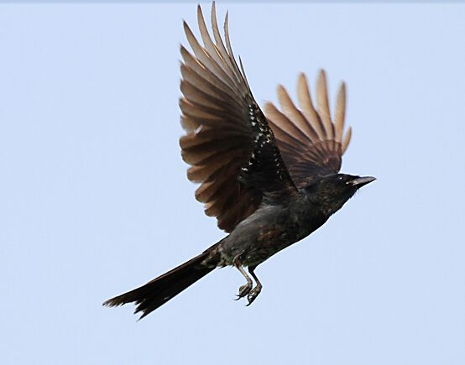
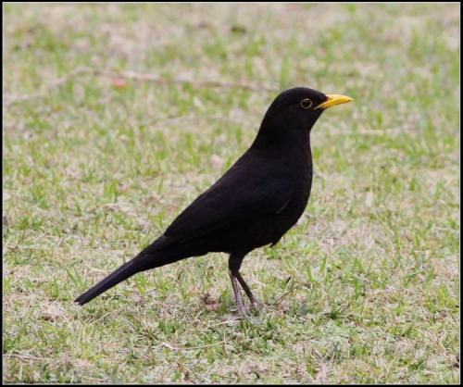
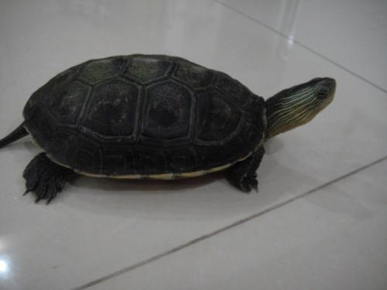
Text-to-Image
[S. Reed, et al., ICML, 2016.]
Problem 2:
Interpolated text embeddings need not correspond to any actual human-written text, so there is no additional labeling cost.
Example:
A black bird is flying in the sky.
Generator
A black bird is crawling on the ground.
A black turtle is crawling on the ground.

Slide 9
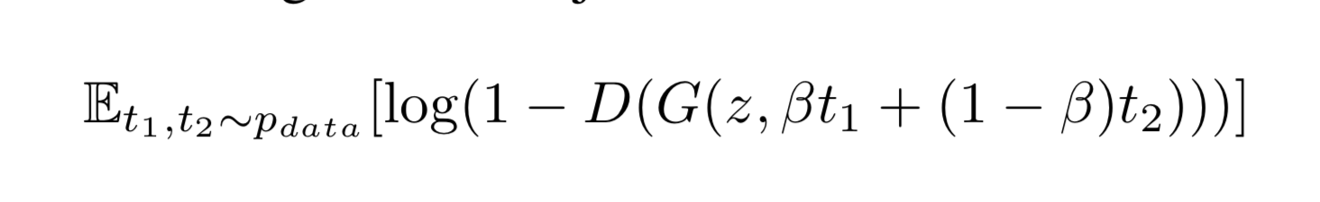
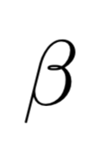
Learning with manifold interpolation (GAN-INT)
[S. Reed, et al., ICML, 2016.]
Generator objective:
:noise distribution
: interpolates

Slide 10
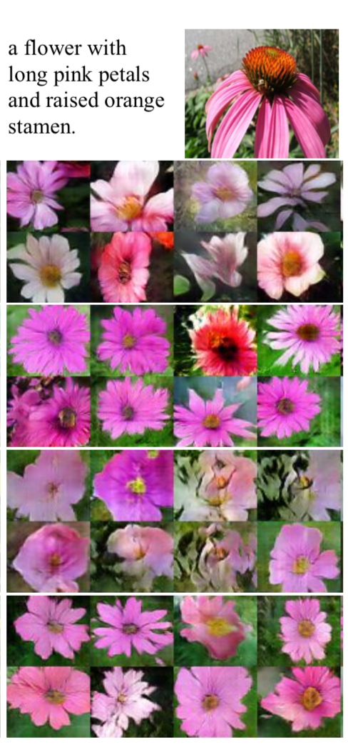
[S. Reed, et al., ICML, 2016.]
GAN
GAN-CLS
GAN-INT
GAN-INT-CLS

Slide 11

Text-to-Image
[A. Odena, et al., ICML, 2016.]
ACGAN
Normal distribution : z
G
Image
x = G(t,z)
text : $\hat{t} t$
x is realistic or not
D
t = 1
t = 2
t = 3
Auxiliary Classifier for Text

Slide 12
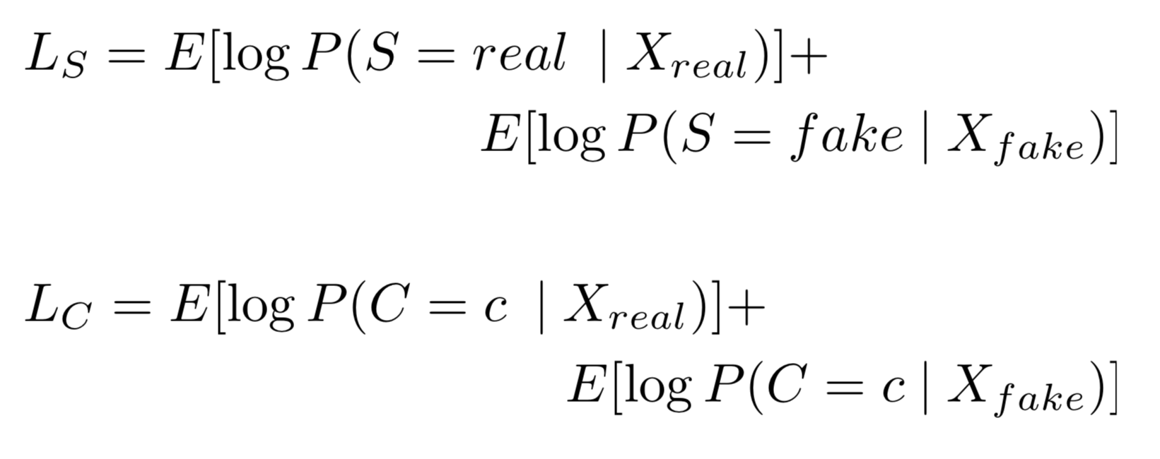
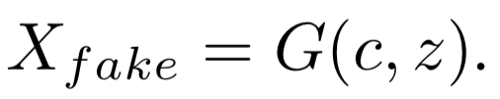
ACGAN
[A. Odena, et al., ICML, 2016.]
Objective function:
The log-likelihood of the correct source
The log-likelihood of the correct class
D: max (LS + LC) G: max (LC - LS )

Slide 13
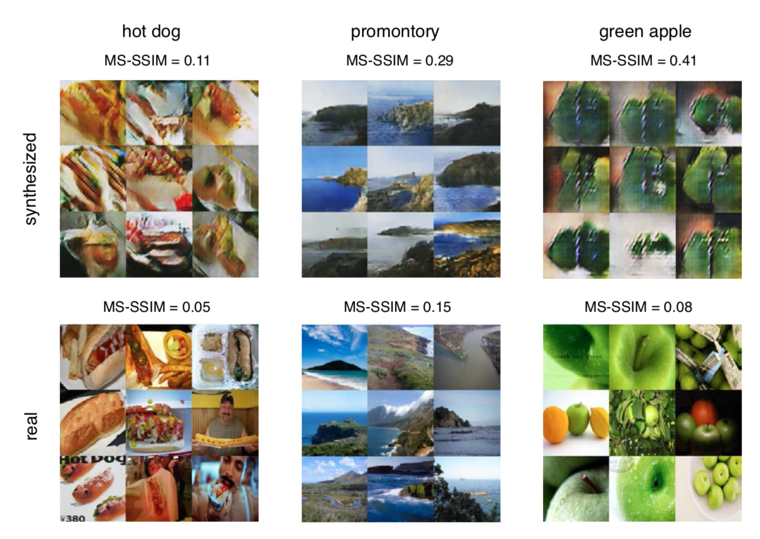
Diversity of Generated Images
[A. Odena, et al., ICML, 2016.]

Slide 14
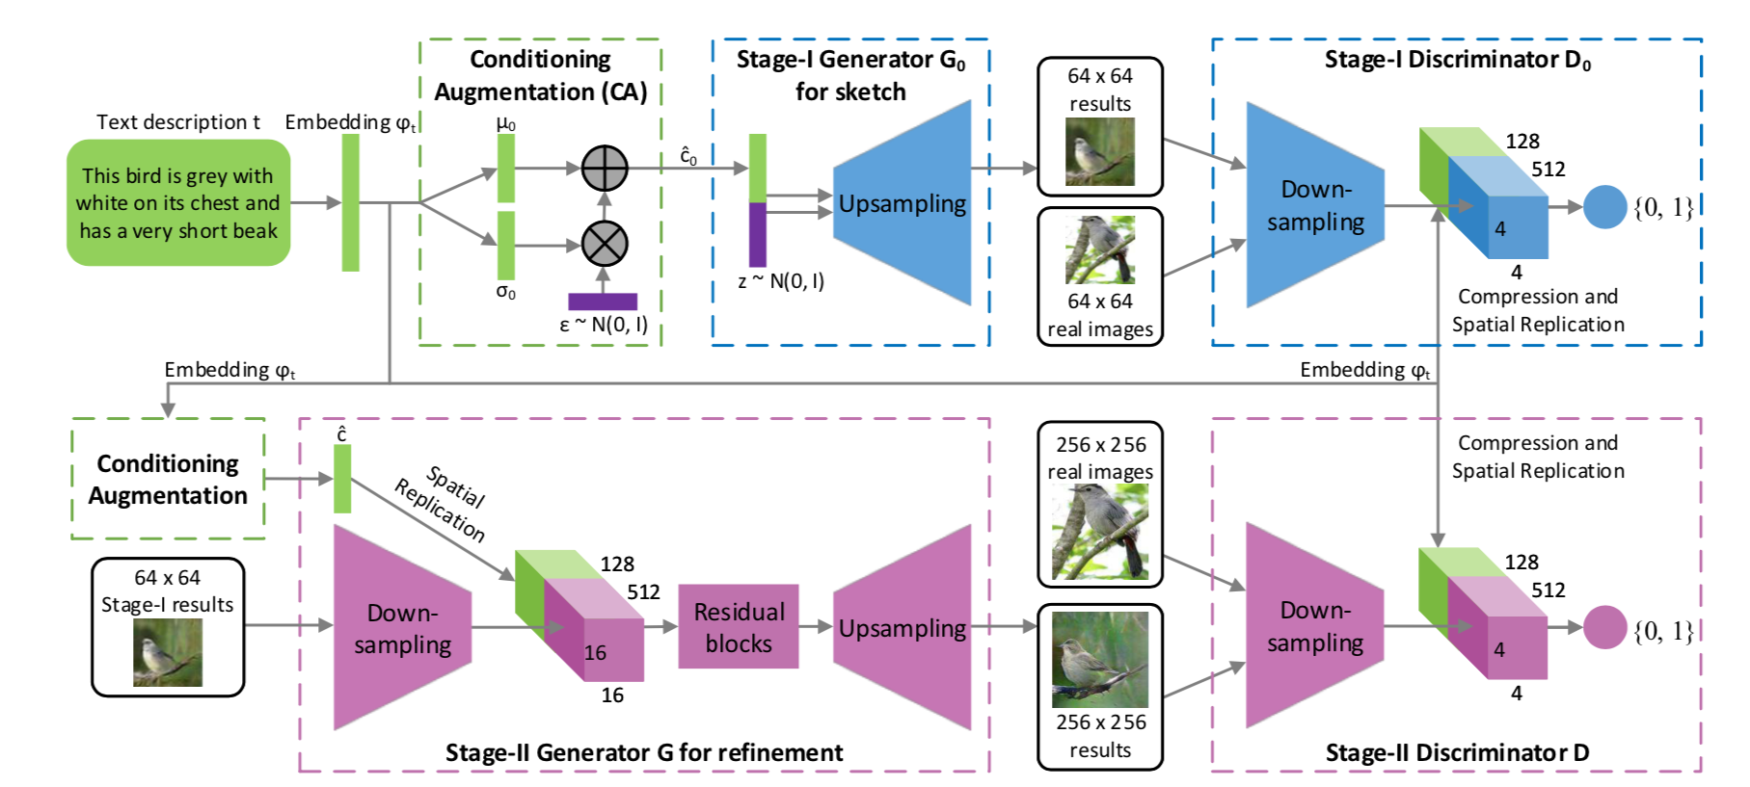
StackGAN
[H. Zhang, et al., ICCV, 2017.]
Problem:
Samples generated by existing text- to-image approaches can roughly reflect the meaning of the given descriptions, but they fail to contain necessary details and vivid object parts.
The Stage-I GAN output low-resolution images. The Stage-II GAN takes Stage-I results and text descriptions as inputs, and gener- ates high-resolution images.

Slide 15
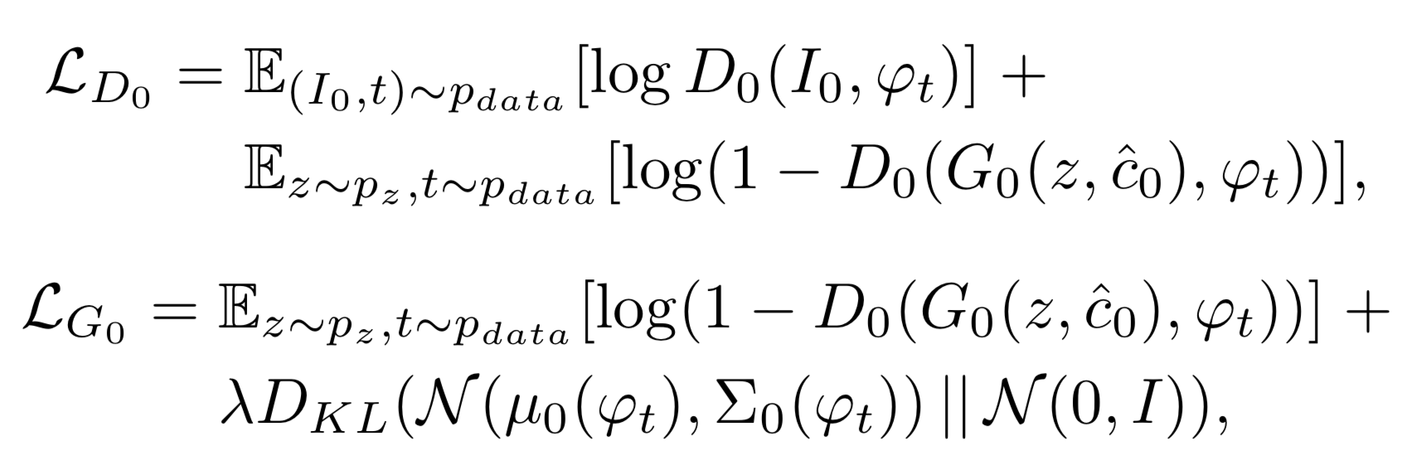
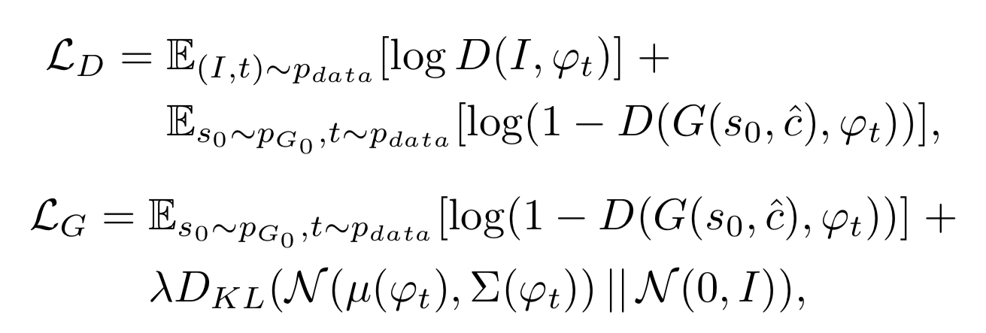
StackGAN
[H. Zhang, et al., ICCV, 2017.]
Objective function:
Stage-I GAN
Stage-II GAN

Slide 16
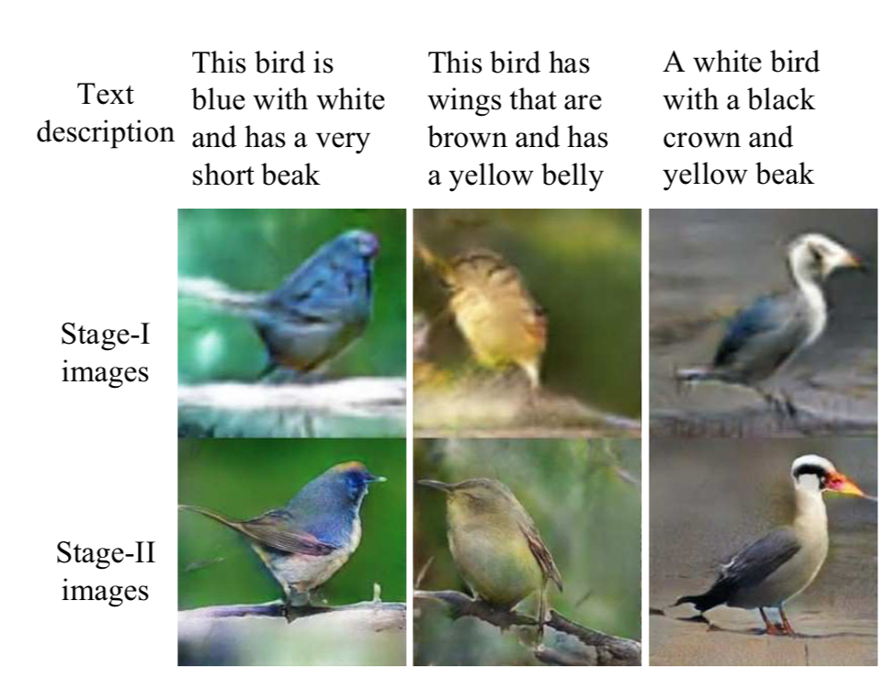
Birds
[H. Zhang, et al., ICCV, 2017.]

Slide 17
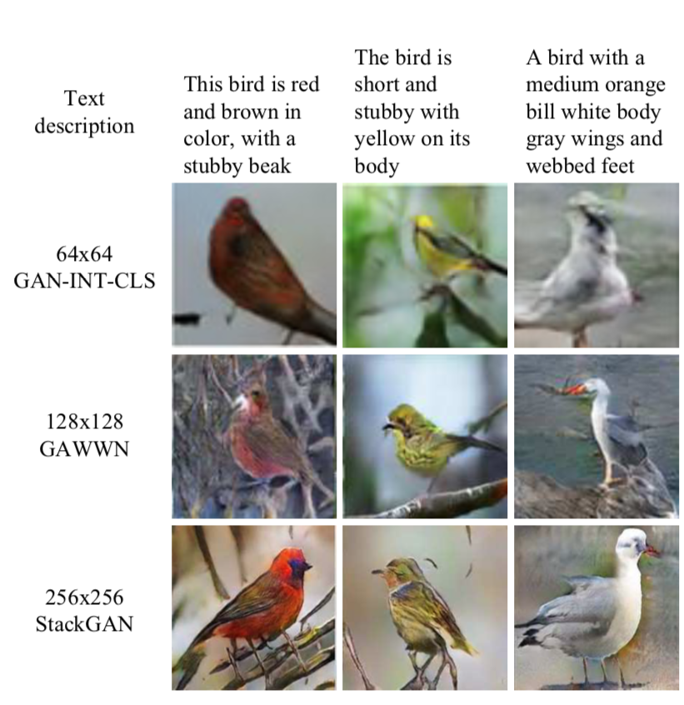
Birds
[H. Zhang, et al., ICCV, 2017.]

Slide 18
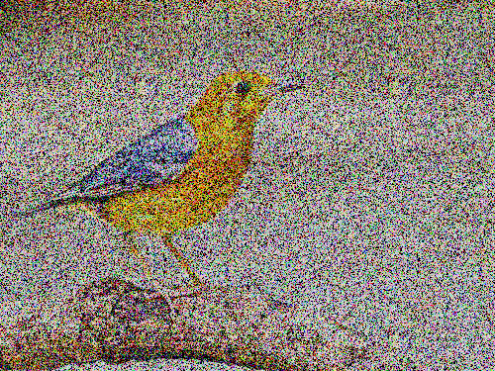
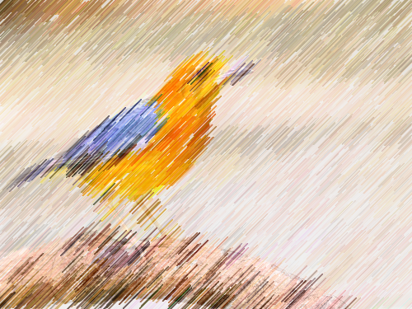
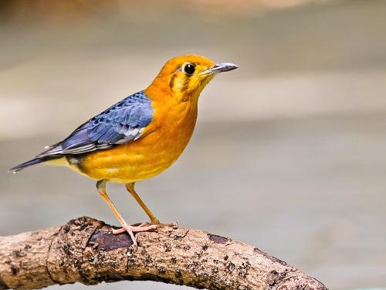
Thinking…
n iters
z
G0
x
D
x
G
x
D
x
t
t
t
t
t
…
V1
V2
Vn

Slide 19
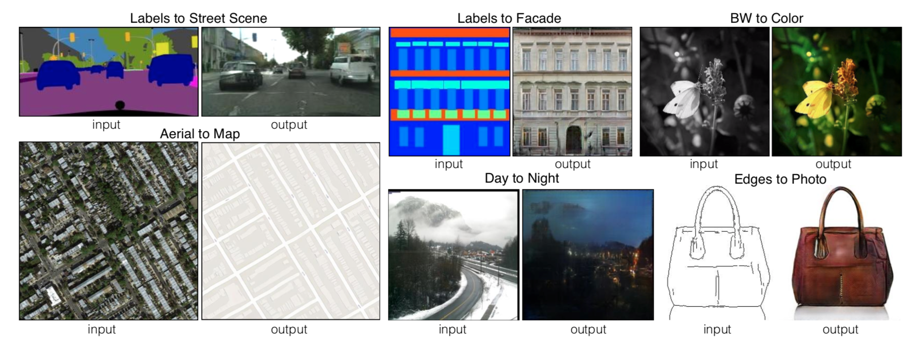
Image-to-Image
[P. Isola, et al., CVPR, 2017.]
pix2pix

Slide 20
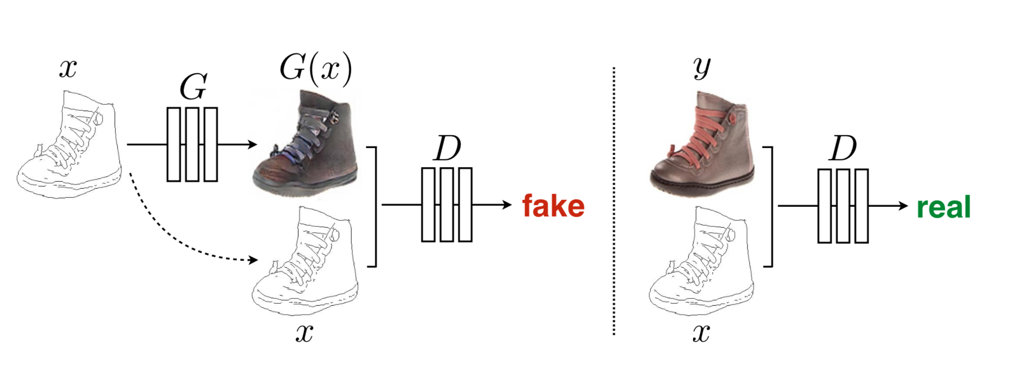
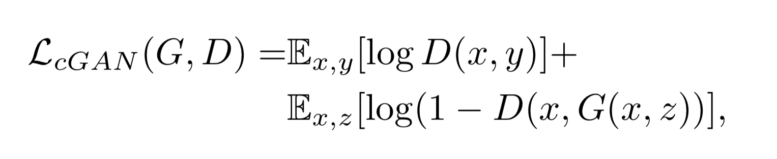
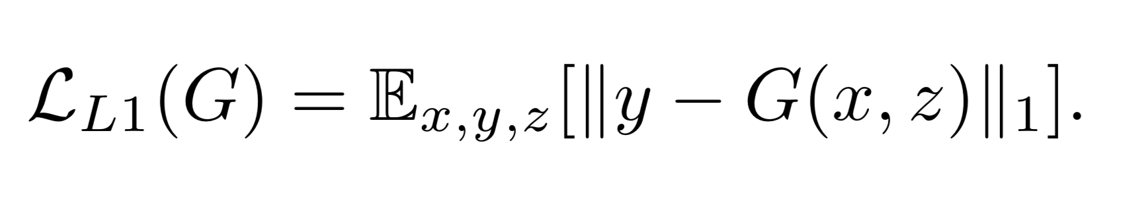
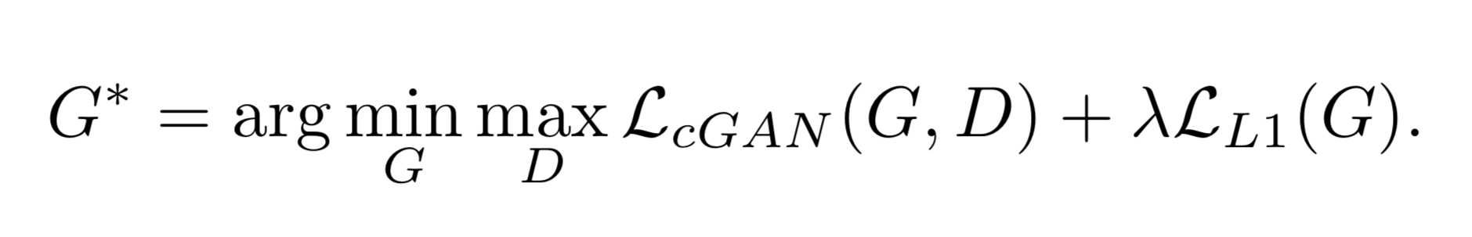
pix2pix
[P. Isola, et al., CVPR, 2017.]
GAN Objective Function:
GAN using L1 distance Objective Function:
Final Objective Function:

Slide 21
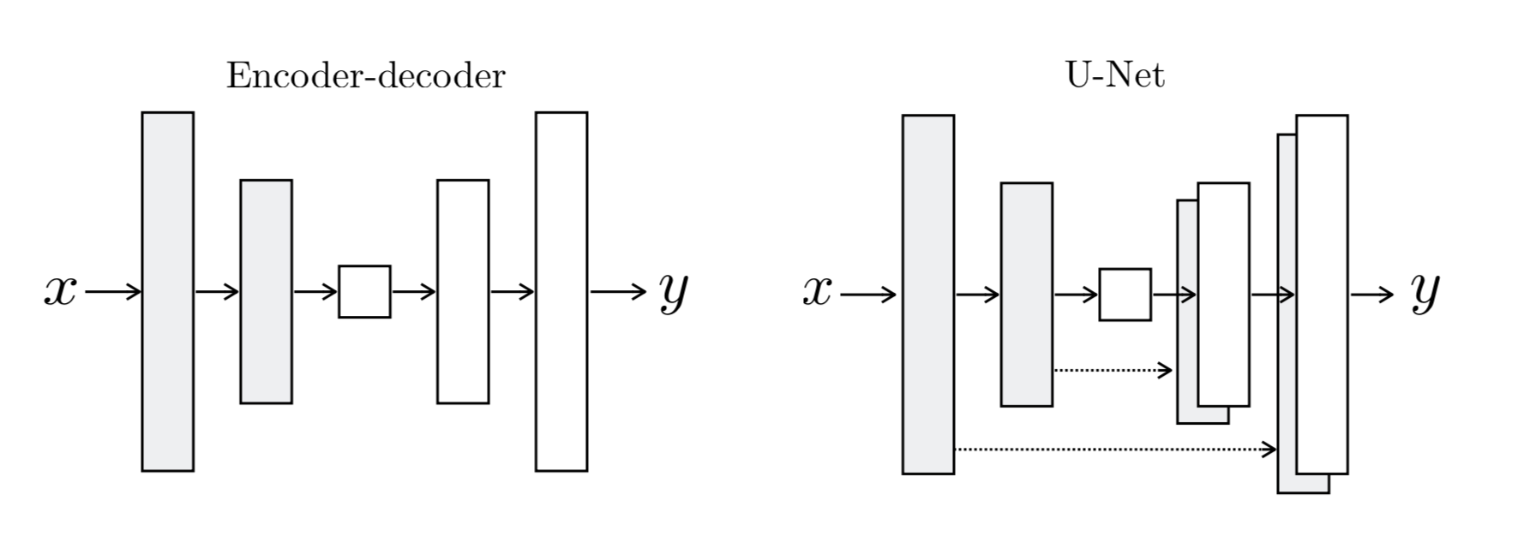
Two architectures for the Generator
[P. Isola, et al., CVPR, 2017.]
bottleneck
bottleneck
Input and Output differ in surface appearance, but have same underlying structure
Low-level information shared between the input and output, and it would be desirable to shuttle this information directly across the net.

Slide 22
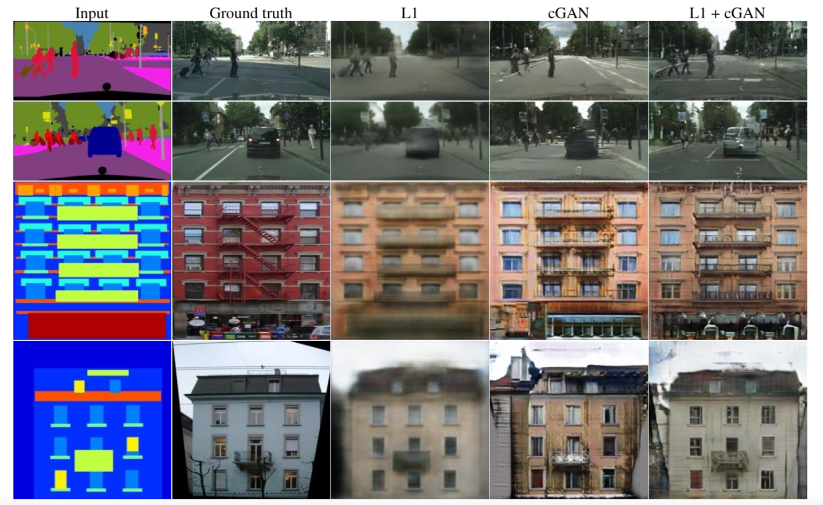
Results

Slide 23
Improve GAN
（Least Squares GAN, LSGAN）

Slide 24
GAN
[Ref: https://www.quora.com/What-are-the-pros-and-cons-of-using-generative-adversarial-networks-a-type-of-neural-network]
Pros:
1.Good method for trainning classifiers in a semi-supervised way.
2.Generate samples faster than belief nets(NADE, PixelRNN).
3.Don’t need any Monte Carol approximations to train.
Cons:
1.Training a GAN requires finding a Nash equilibrium of a game.
2.It’s hard to learn to generate discre data, like text.
3.GAN is hard to do things like guess the value of one pixel given another pixel.

Slide 25
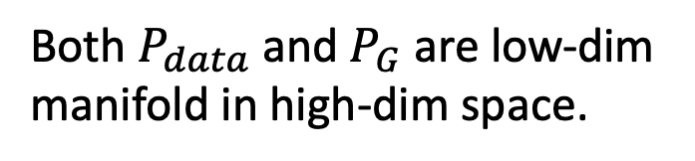
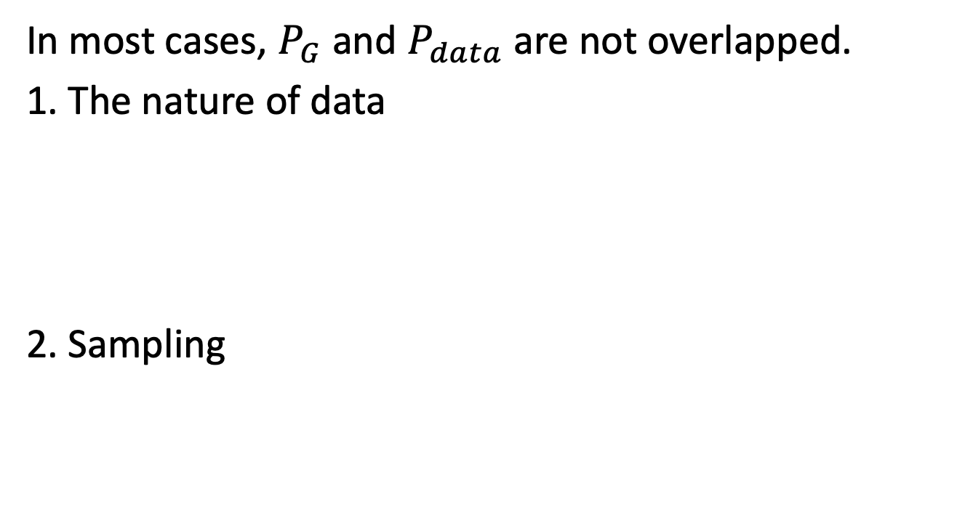
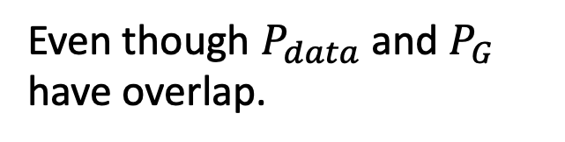
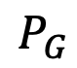
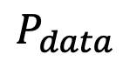
Problem
[Ref: http://speech.ee.ntu.edu.tw/~tlkagk/courses_MLDS17.html]
In most cases, $P_{G}$ and $P_{data}$ are not overlapped.
1. The nature of data
2. Sampling
Both $P_{data}$ and $P_{G}$ are low-dim manifold in high-dim space.
$$P_{G}$$
$$P_{data}$$
The overlap can be ignored.
Even though $P_{data}$ and $P_{G}$ have overlap.
If you do not have enough sampling ……

Slide 26
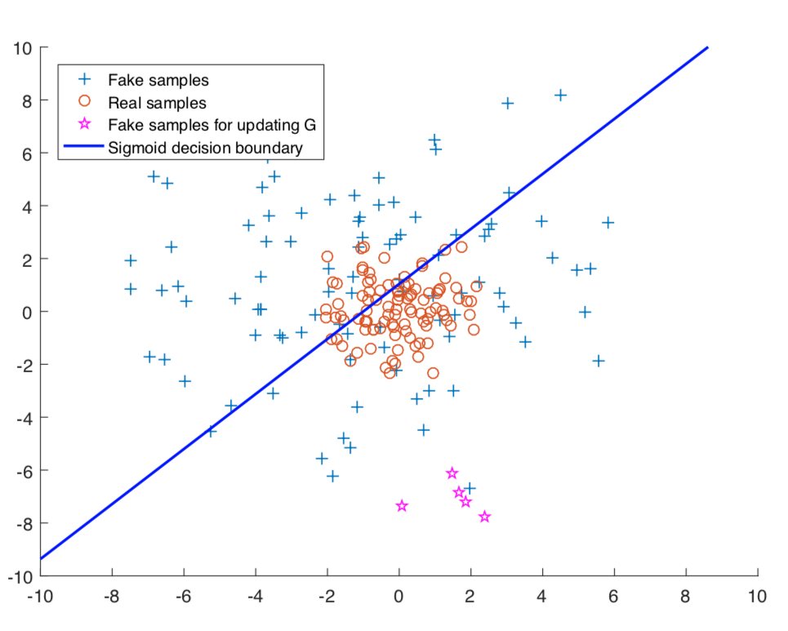
Problem
[X. Mao, et al., arXiv:1611.04076, 2016.]
LSGAN

Slide 27
LSGAN
real
fake
Replace sigmoid with linear(replace classification with regression)
sigmoid
linear
1
0
x1
x2
x1
x2
x1 = x2
x1 > x2

Slide 28
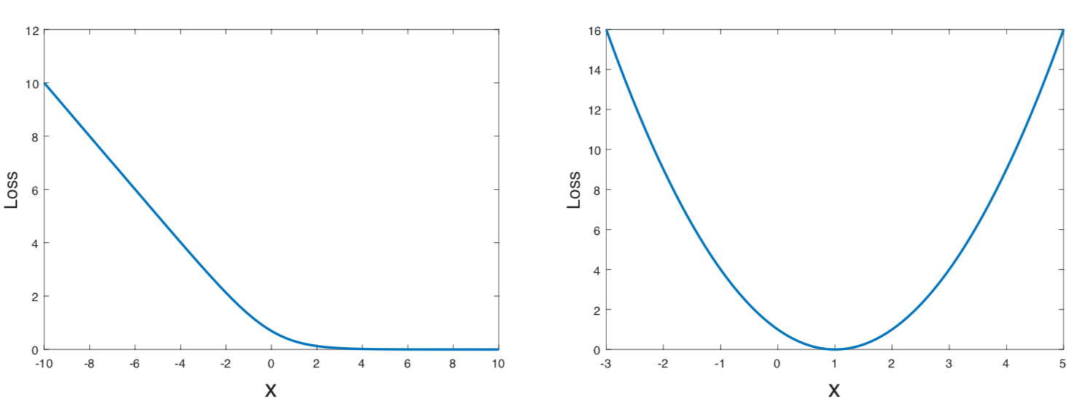
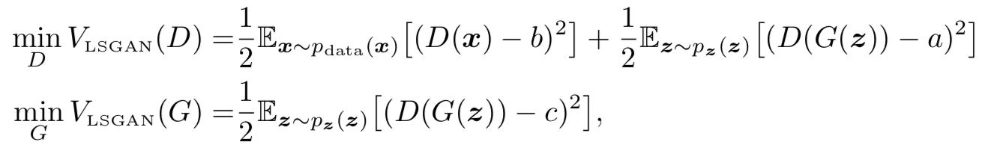
LSGAN
[X. Mao, et al., arXiv:1611.04076, 2016.]
The sigmoid cross entropy loss function
The least squares loss function
LSGAN Objective Function:

Slide 29
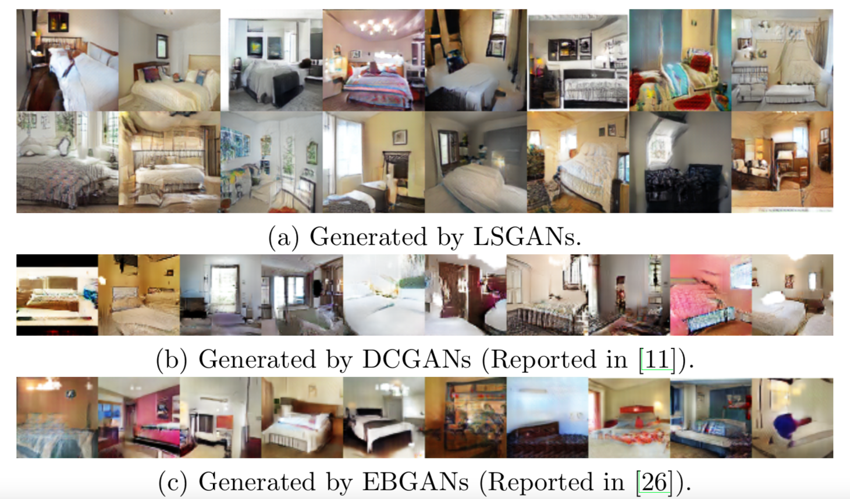
Generated Images
[X. Mao, et al., arXiv:1611.04076, 2016.]

Slide 30
Thinking…
Have some improvements on the structure？
z
G
x
D
1
scalar
t
t
0

Slide 31
Thinking…
Have some improvements on the structure？
z
G
x
D
1
scalar
t
t
0
z
G
x
t
t
Multi Agent Diverse GAN
MADGAN
z
G
x
D
1
scalar
t
t
0
z
G
x
t
t

Slide 32
References
https://github.com/wilwiz/cgan
[1]I. J. Goodfellow et al., “Generative Adversarial Networks,” arXiv:1406.2661 [cs, stat], Jun. 2014.
[2]A. Radford, L. Metz, and S. Chintala, “Unsupervised Representation Learning with Deep Convolutional Generative Adversarial Networks,” arXiv:1511.06434 [cs], Nov. 2015.
[3]P. Isola, J.-Y. Zhu, T. Zhou, and A. A. Efros, “Image-to-Image Translation with Conditional Adversarial Networks,” arXiv:1611.07004 [cs], Nov. 2016.
[4]X. Mao, Q. Li, H. Xie, R. Y. K. Lau, Z. Wang, and S. P. Smolley, “Least Squares Generative Adversarial Networks,” arXiv:1611.04076 [cs], Nov. 2016.
[5]A. Odena, C. Olah, and J. Shlens, “Conditional Image Synthesis with Auxiliary Classiﬁer GANs,” p. 10, 2016.
[6]S. Reed, Z. Akata, X. Yan, L. Logeswaran, B. Schiele, and H. Lee, “Generative Adversarial Text to Image Synthesis,” p. 10, 2016.
[7]H. Zhang, T. Xu, and H. Li, “StackGAN: Text to Photo-Realistic Image Synthesis with Stacked Generative Adversarial Networks,” in 2017 IEEE International Conference on Computer Vision (ICCV), Venice, 2017, pp. 5908–5916.
[8]http://speech.ee.ntu.edu.tw/~tlkagk/courses_MLDS17.html
[9] https://www.quora.com/What-are-the-pros-and-cons-of-using-generative-adversarial-networks-a-type-of-neural-network
[10]https://github.com/hindupuravinash/the-gan-zoo

